Slide 1

Parking Impact Intelligence System AI-Driven Detection, Forecasting and Enforcement Planning for Parking-Induced Congestion
By

Slide 2
Problem Statement
Current Challenges
Illegal parking causes traffic bottlenecks and lane reduction.
Enforcement is reactive and patrol-based.
No prioritization of high-risk zones.
Limited visibility into repeat offenders.
Resource deployment relies heavily on experience.
Impact
Increased congestion
Reduced road capacity
Delayed emergency response
Inefficient enforcement allocation

Slide 3
Dataset Overview
Parking Violation Dataset
298,450 violation records
54 police stations
169 junctions
10,942 locations
Nov 2023 – Apr 2024
Include a simple dataset statistics graphic.

Slide 4
Proposed Solution
Historical Parking Violations
↓
Feature Engineering
↓
Hotspot Detection
↓
Forecasting Engine
↓
Risk Classification
↓
EPI Scoring
↓
Recommendation Engine
↓
Traffic Police Dashboard
↓
Targeted Enforcement
1. Hotspot Detection
Analyze historical parking violation data to identify congestion-prone junctions and parking hotspots.
2. Violation Forecasting
Use machine learning models to predict future parking violation intensity based on location and time patterns.
3. Enforcement Intelligence Dashboard
Visualize hotspots, risk levels, forecasts, and enforcement recommendations through an interactive dashboard.

Slide 5
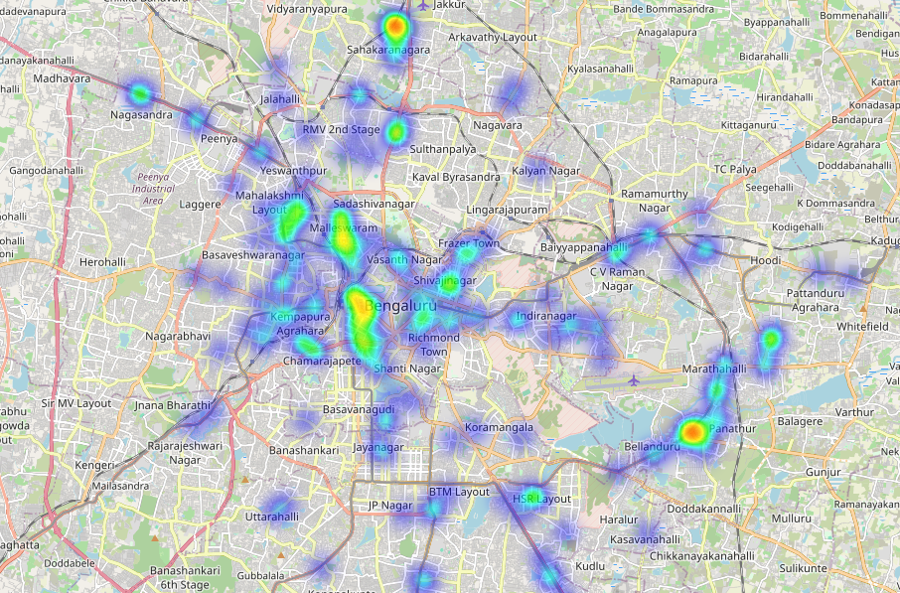
Parking Violation Heatmap
Visualizes the spatial distribution of historical parking violations across Bengaluru.
Highlights areas with consistently high violation density and congestion potential.
Serves as the foundation for hotspot detection, risk analysis, and enforcement planning.
Key Insight
Violation density is concentrated around commercial corridors and major junctions.
Enables rapid identification of congestion-prone zones.

Slide 6
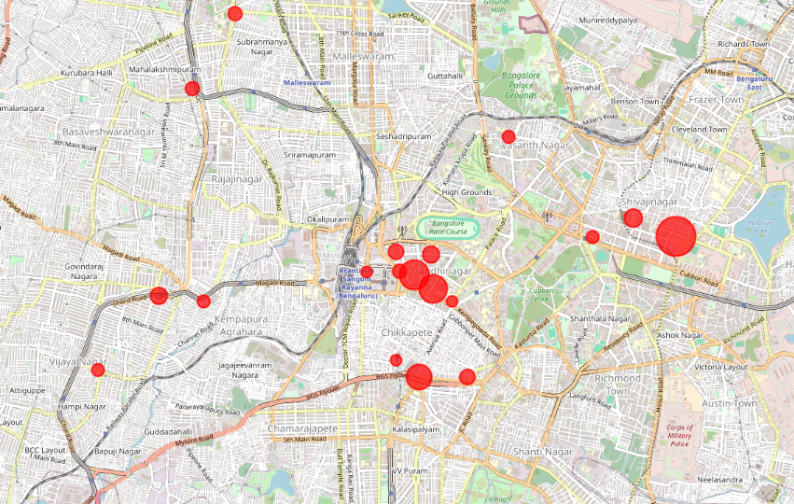
Risk Map & EPI
Enforcement Priority Index (EPI)
Ranks hotspots based on:
Violation frequency
Peak-hour activity
Repeat offender concentration
Top Hotspots
Safina Plaza Junction
Elite Junction
Sagar Theatre Junction
KR Market Junction

Slide 7
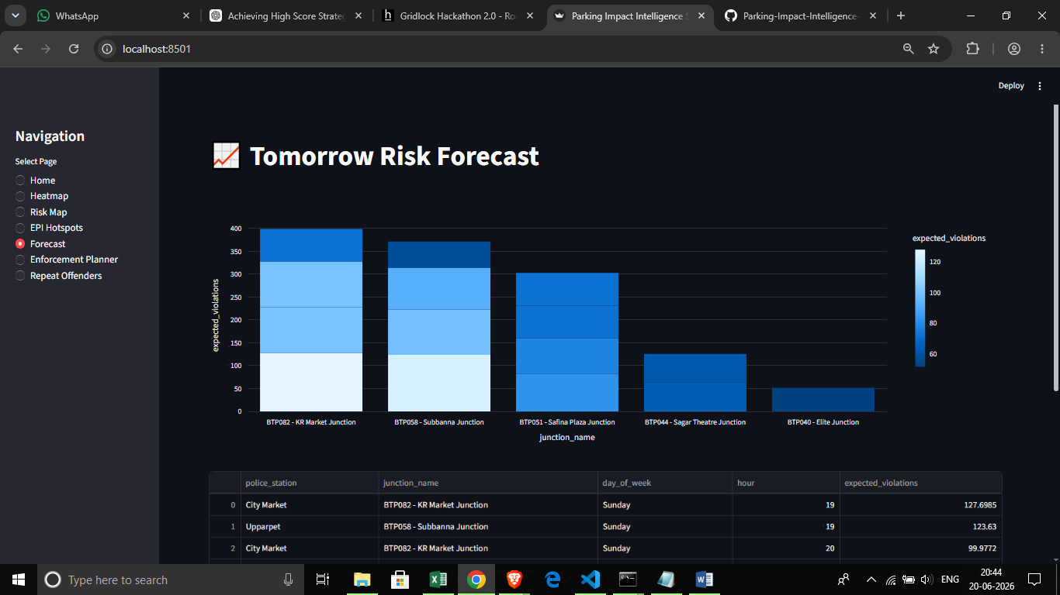
Forecasting Engine
Predicts future parking violation intensity using historical spatial and temporal patterns.
Utilizes a CatBoost Regressor trained on location and time-based violation data.
Forecasts violation volume at hotspot locations before congestion escalates.
Supports proactive officer deployment and targeted enforcement planning.
Key Inputs: Police Station • Junction • Day of Week • Hour of Day
Performance: MAE = 9.49 violations

Slide 8
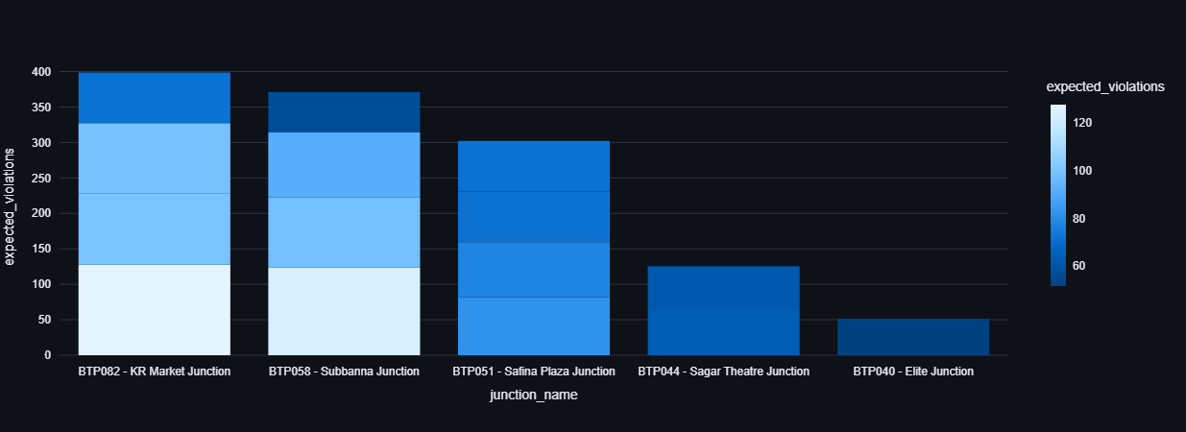
Repeat Offender Analysis
Detects vehicles with a history of frequent parking violations.
Prioritizes high-risk repeat offenders for focused enforcement.
Helps authorities prevent recurring congestion caused by habitual violators.

Slide 9
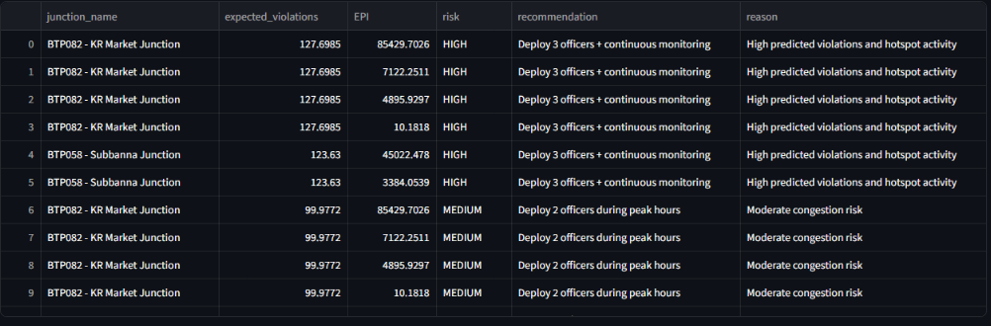
Enforcement Planner
Prioritizes hotspot locations based on predicted violation risk and EPI scores.
Recommends optimal deployment of traffic personnel and monitoring resources.
Enables proactive enforcement to reduce parking-induced congestion and improve traffic flow.

Slide 10
Impact & Future Scope
Impact
Prioritized enforcement
Reduced parking-induced congestion
Better resource allocation
Data-driven decision making
Future Scope
Real-Time CCTV Integration
Live Violation Data Ingestion
Dynamic EPI Score Updates
Automated Enforcement Alerts
Smart City & Traffic Control Integration

Slide 11
Thank You
https://github.com/GayaStar/Parking-Impact-Intelligence-System.git
https://parking-impact-intelligence-system.streamlit.app

